Slide 1


MINDMATE
An Interactive Mental Wellness Companion
Julian Fimbres
CIS129

Slide 2



INTRODUCTION TO THE TOPIC
Why mental health?
Mental health issues like anxiety, stress, and depression affect 1 in 8 people globally (WHO).
Many suffer in silence due to the cost of therapy or lack of accessible tools.
Why I care: As a student, I’ve seen how stress can affect focus, energy, and confidence. This motivated me to explore how software can support emotional well-being affordably.

Slide 3

Mental health support traditionally relied on face-to-face therapy.
SUMMARY OF FINDINGS – HISTORY
Self-help books and practices like journaling and meditation emerged to aid self-regulation.
Historical Context
With smartphones, digital wellness became a growing field.

Slide 4



CURRENT SOLUTIONS
Headspace, Calm: Excellent but mostly behind a paywall
What Exists Now
Daylio: Great for mood tracking, but lacks interactive support
General journaling apps: Often too open-ended or unstructured
Gap Identified: No free, integrated app for daily check-ins, guided support, and trends tracking.

Slide 5


HOW CAN THIS HELP?
Real-World Applications
Students managing academic stress
Workers coping with burnout
Anyone developing emotional awareness
Use Cases:
Quick daily check-ins between tasks
Access to grounding exercises during a panic attack
Journaling emotions after a tough day

Slide 6


Step 1: User Pain Points — Stress, inaccessibility, lack of structure
Step 2: Feature Brainstorm — What would I want in a mental health buddy?
Step 3: User Flow Design — Simple mood input → Smart response → Support
Step 4: Minimalist Interface — Calm, easy to use, and non-overwhelming
MY DESIGN APPROACH
How I Started Designing

Slide 7

SOLUTION DESIGN PROPOSAL – MINDMATE
Core Features
Daily Mood Check-In with emojis/sliders
AI Assistant
Coping Strategy Materials (e.g., breathing, grounding)
Emotion Trends Tracker (charts, streaks, calendar)
Emergency Call Button
Pastel UI, tabs for Home | Chat | Resources | Call

Slide 8
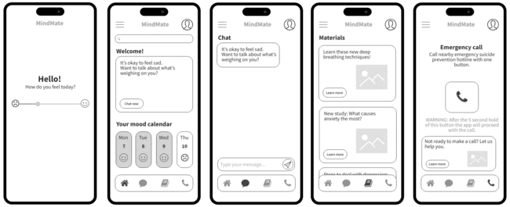
MOCK-UP UI DESIGN

Slide 9
Function DailyCheckIn():
mood = GetMoodInputFromUser()
SaveToDatabase(user_id, date, mood)
journal_prompt = GeneratePrompt(mood)
DisplayPrompt(journal_prompt)
Function GeneratePrompt(mood):
If mood == "sad":
Return "What happened today that made you feel down?"
Else if mood == "anxious":
Return "What is on your mind right now?"
Else if mood == "happy":
Return "What made you smile today?"
...
Function SuggestCopingStrategies(mood):
If mood == "anxious":
Return ["Try the 4-7-8 breathing technique", "Write down 3 worries and a positive thought"]
Else if mood == "angry":
Return ["Do a 5-minute grounding exercise", "Go for a walk"]
...
Function ShowEmotionTrends():
mood_data = GetPast30DaysMood(user_id)
DisplayGraph(mood_data)
PSEUDOCODE
Function DailyCheckIn() - Collects user's current mood, saves the mood data to the database, generates a personalized journal prompt, displays that journal prompt to the user.
Function GeneratePrompt(mood) - Checks the mood (e.g., sad, anxious, happy) and returns a mood-specific question or reflection prompt.
Function SuggestCopingStrategies(mood) - Checks the mood and returns a list of practical coping strategies.
Function ShowEmotionTrends() - Retrieves mood data from the past 30 days using GetPast30DaysMood(user_id) and then displays a graph of the data to visualize emotional highs/lows and streaks.

Slide 10
OPEN QUESTIONS & INSIGHTS
What I Still Wonder
How can we measure if someone’s mood actually improved after using the app?
What’s the safest way to handle crisis or emergency situations within the app?
What Surprised Me:
The overlap in user pain points—people just want to be understood and guided.
How powerful simple check-ins can be when done regularly.

Slide 11

CITATIONS
WHO Mental Health Statistics: https://www.who.int/news-room/fact-sheets/detail/mental-health-strengthening-our-response
Headspace: https://www.headspace.com
Calm: https://www.calm.com
Daylio App: https://daylio.net
APA Stress Facts: https://www.apa.org/news/press/releases/stress
UX Design Research: https://uxdesign.cc

Slide 12

CONCLUSION
MindMate is not just an app—it’s a daily check-in companion.
It fills the gap between clinical therapy and passive mood tracking.
By blending emotional journaling, smart support, and accessible tools, MindMate can help users better understand and care for their mental health—one check-in at a time.
Final Thoughts

Slide 13
Julian Fimbres
CIS129
THANK YOU FOR YOUR ATTENTION!

